Slide 1
Text Classification
Raghav Bali
Staff Data Scientist DeliveryHero, Berlin

Slide 2
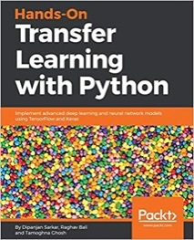
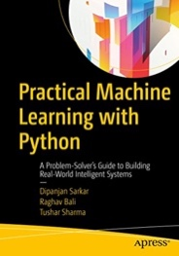
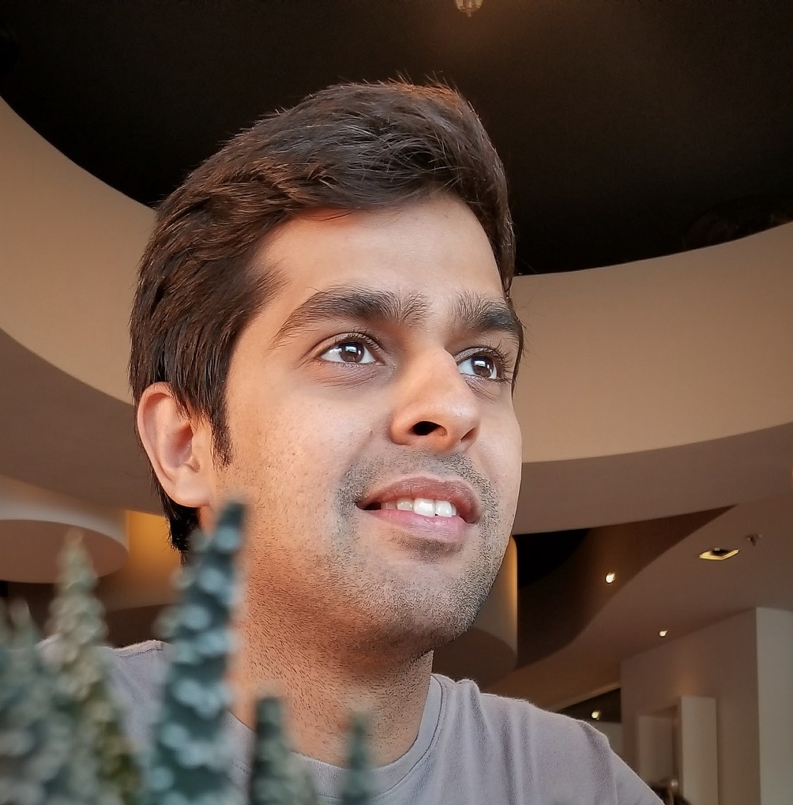

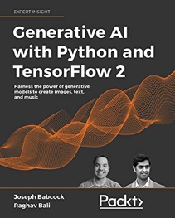


Raghav Bali
Staff Data Scientist
Author of Multiple Books
Inventor with 7+ patents
Speaker at Top Events

Slide 3
Agenda
What is NLP
Applications of NLP
Complexities
NLP Workflow
Context
Deep Learning and NLP

Slide 4

Natural Language
Highly Unstructured in Nature
Way of Communication
Too Many Variations
Difficult to Ingest/Parse
Available All Around Us

Slide 5
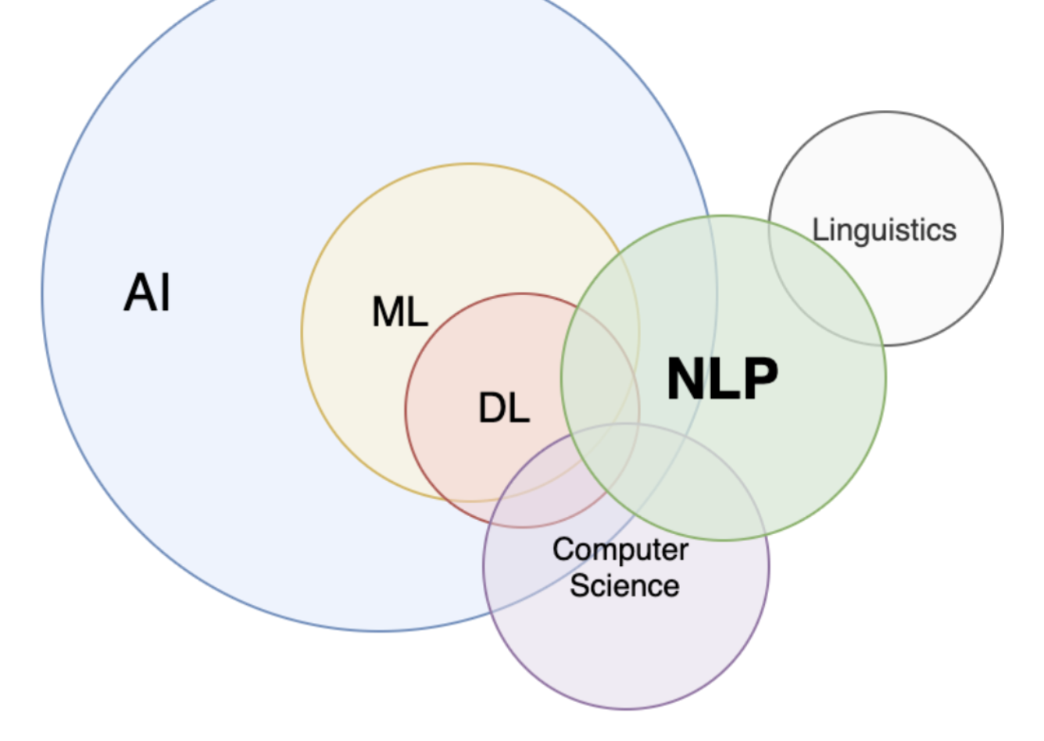
What is NLP?
Intersection of :
Linguistics
Computer Science
AI
NLP is about:
Processing text
Analyzing unstructured information
Understand, Generate and Communicate

Slide 6
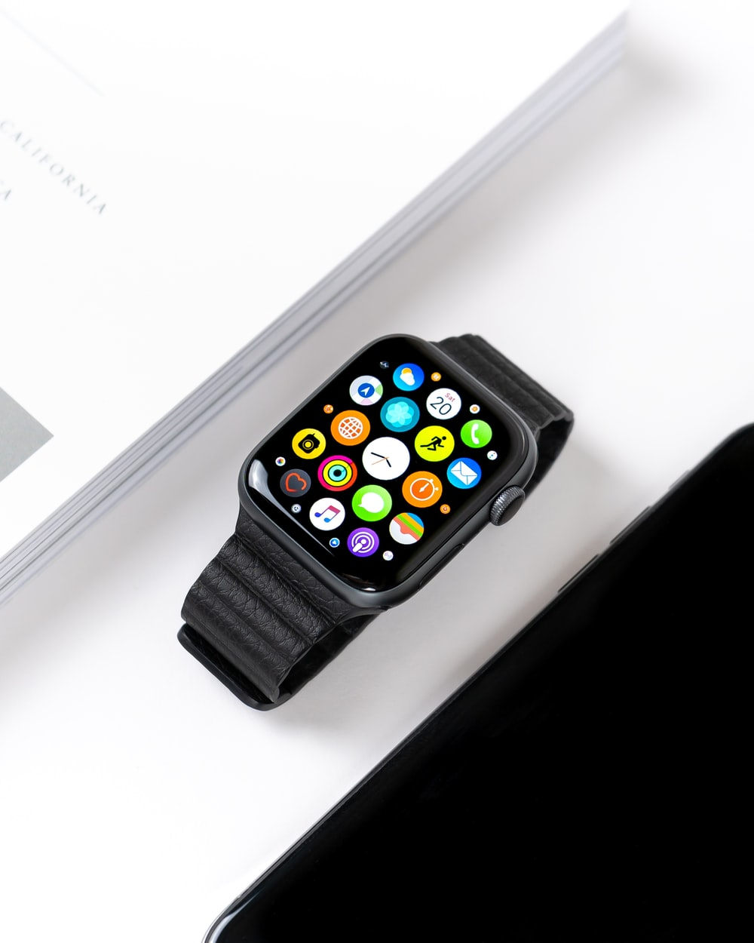






Applications
Text Classification Sentiment Analysis, Spam Detection, Document Categorization
Information Retrieval Search, Chat-bots, Question Answering
Text Summarization News Excerpts, Document/Book Summary, Topic Modeling
Machine Translation English to Hindi, German to French…
Text Generation Creative writing, Headline creation, Meme text
Speech Analysis AI Assistants, Speech to Text

Slide 7


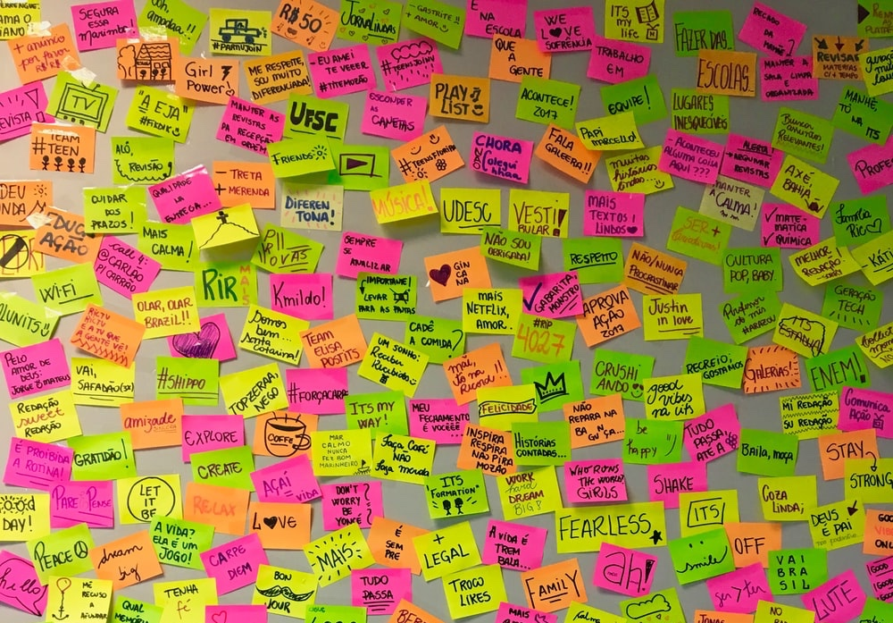
Language and its Complexities
Languages are complex and have fuzzy grammatical rules and structures.
Every Language is defined with a list of characters called the alphabet, a list of words called the vocabulary and a set of rules to use the words called grammar.
Most learning algorithms are designed to work with numbers, matrices, vectors…

Slide 8
Typical NLP Workflow
Preprocessing
Cleanup
Standardization
Feature Engineering
Tokenization
Text Representation
Modeling
Train
Evaluate and Deploy

Slide 9


Time for Some Action
Hands-on - I
https://github.com/raghavbali/workshop_text_classification

Slide 10
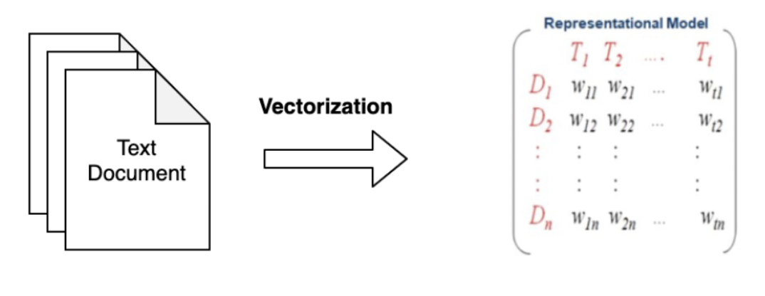
Text Representation Models
Textual data is not directly ingestible
We need methods to transform text into useful format
Text Representation Models help in “vectorizing” textual data

Slide 11
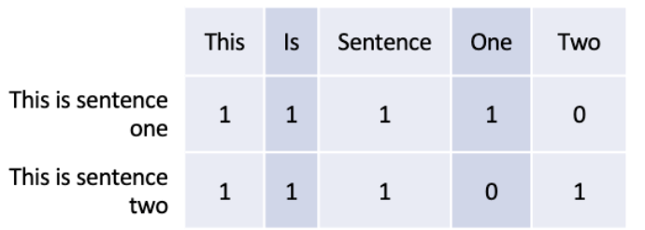
Text Representation Models
Bag of Words
Matrix Transformation of textual data
Ordering of words is ignored
Matrix:
Columns are words of the vocabulary
Rows are documents/sentences
Cell values are count of occurrences
TF-IDF
Improvement on top of BoW
Counts are normalized based on inverse document frequency
More robust to noise
Co-Occurrence Matrices
Matrix:
Column are words of the vocabulary
Rows are words of the sentence
Cell values are number of times a word in the given row exists in the context of the words in the columns
Good at capturing word associations

Slide 12
Time for Some Action
Hands-on – II and III
https://github.com/raghavbali/workshop_text_classification

Slide 13
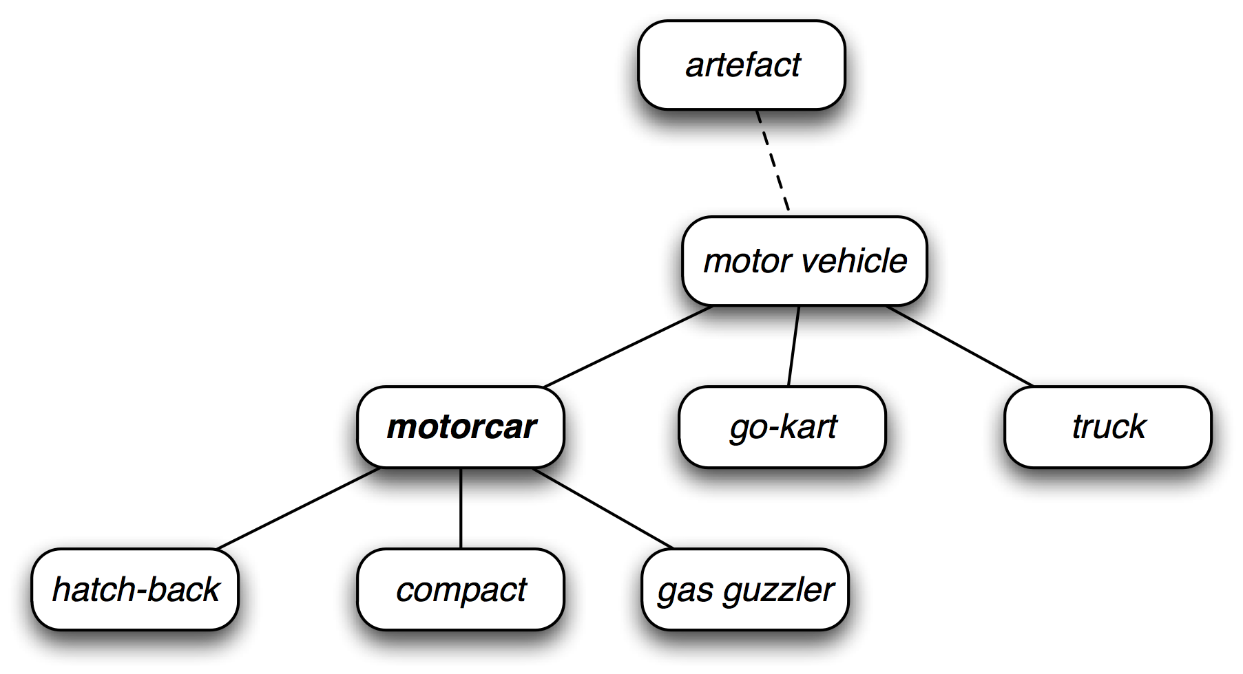
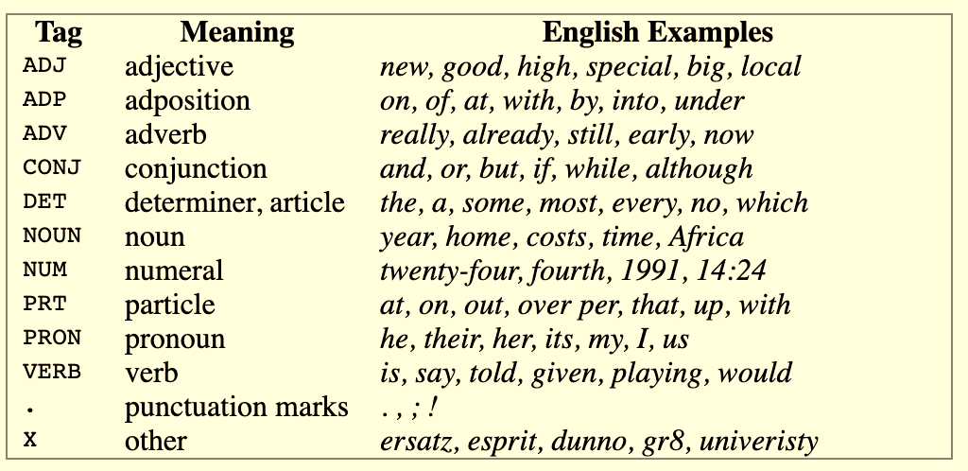
The Wordnet Way
Linguistic way of looking at words and their meanings
a lexical database of semantic relations between words in more than 200 languages
WordNet links words into semantic relations including synonyms, hyponyms, and meronyms
Notes:
Image Source: nltk.org
Discrete Representation

Slide 14
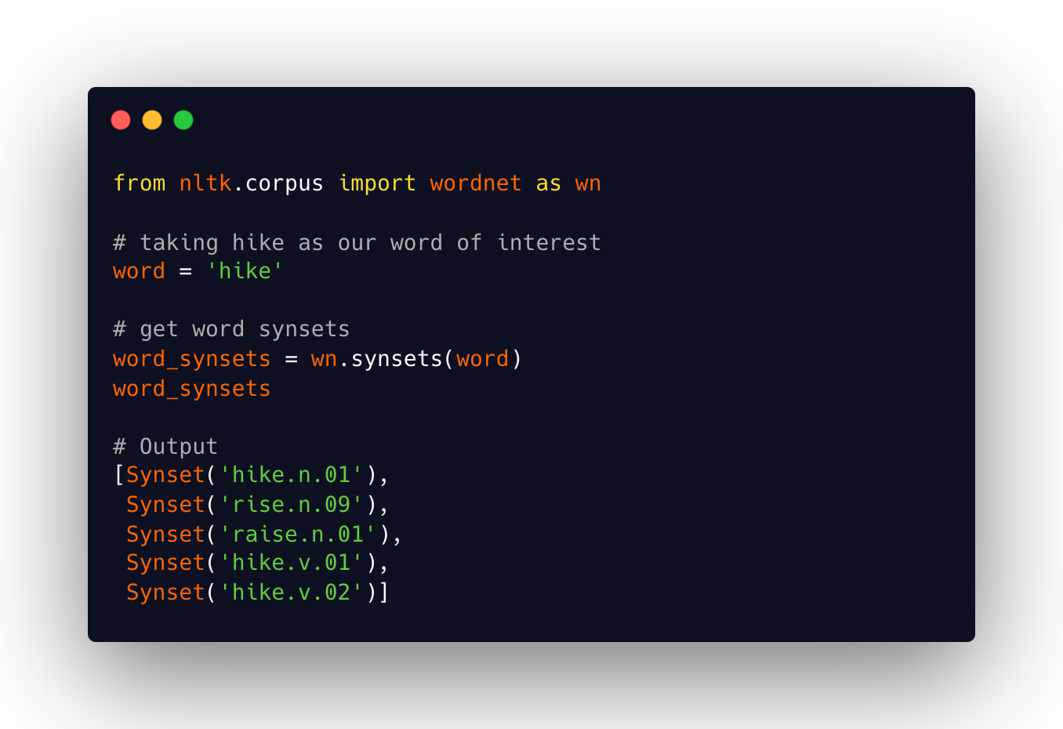
The Wordnet Way
Linguistic way of looking at words and their meanings
a lexical database of semantic relations between words in more than 200 languages
WordNet links words into semantic relations including synonyms, hyponyms, and meronyms
Notes:
Image Source: nltk.org
Discrete Representation

Slide 15
Context
Did you see the look on her face?
The new clock-face on my watch is amazing
It is time to face my demons
How many new faces did you see in office today?
Notes:
JR Firth : British Linguist

Slide 16
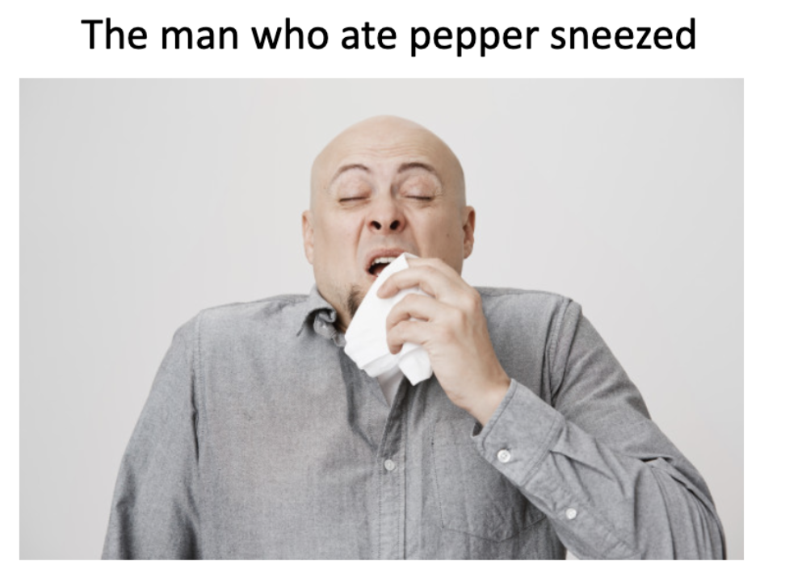
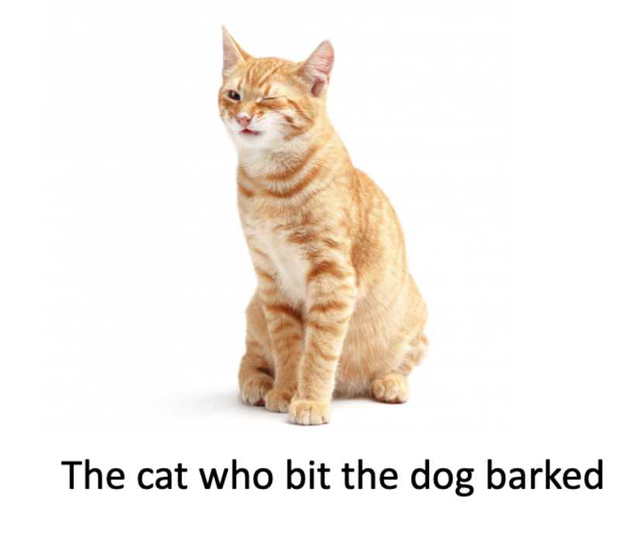
Non-Local Interactions

Slide 17
You shall know a word by the company it keeps
- J.R Firth

Slide 18
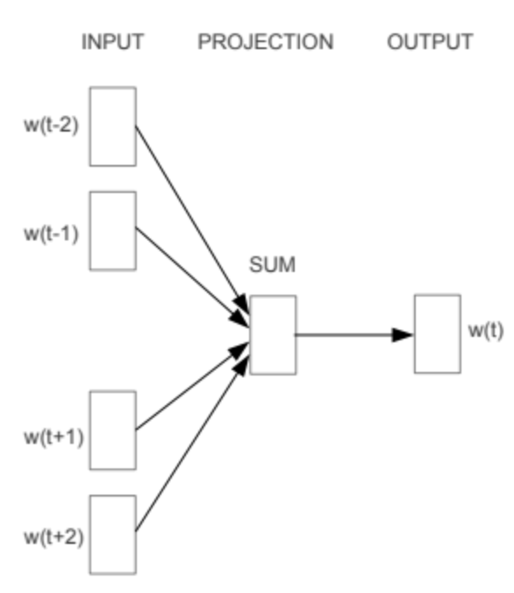
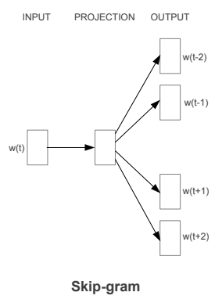
Word Embeddings
Word2Vec
Vector representation based on local context
Variations:
CBOW
Skip-Gram
Dense representations
Context Words
Context Words
This is how
embeddings work now
Word2Vec
word
CBOW
Notes:
Distributional similarity
Bengio 2003 -> Collobert 2008 -> Mikolov 2013
Mikolov et. al.

Slide 19
Word Embeddings
Word2Vec
Vector representation based on local context
Variations:
CBOW
Skip-Gram
Dense representations
GloVe
Based on Global and Local contexts
Dense representation with performance on par with Word2Vec
FastText
Extension of Word2Vec setup
Handles out of vocabulary terms better than Word2Vec and GloVe
Notes:
https://twitter.com/jhuclsp/status/1346466569476399104

Slide 20

Deep Learning and NLP
Embeddings
RNNs
Attention is All You Need
Transformers
BERT and Friends

Slide 21
Time for Some Action
Hands-on - IV
https://github.com/raghavbali/workshop_text_classification

Slide 22
End

